Slide 1
US 301 over four hole swamp
EARLY COORDINATION MEETING
MARCH 3, 2022

Slide 2
Disclaimer
All information provided today is for information only, non-binding, does not constitute legal or other advice, and does not amend or form part of the Final Request for Proposals (RFP).

Slide 3
Purpose
Provide Information
Get Feedback & Answer Questions
Gauge Industry Interest & Competition

Slide 4
Agenda
Location/ Overview
Procurement Type
Scope of Work
Schedule
Q&A

Slide 5
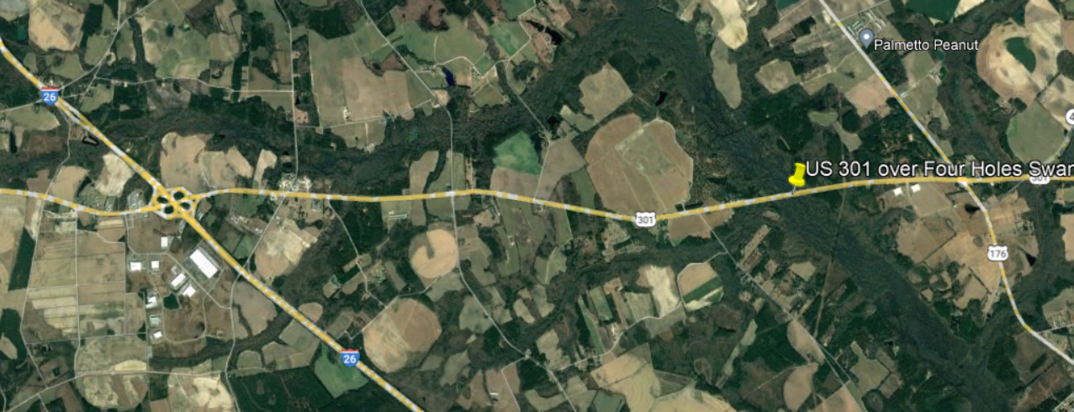
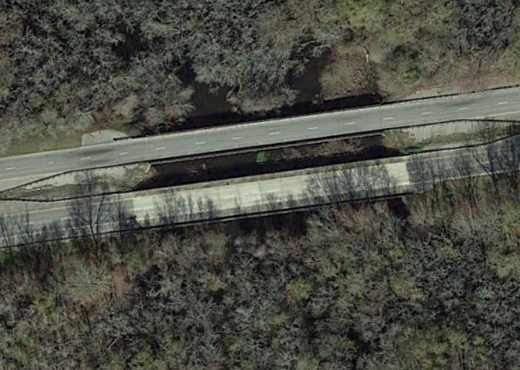
Project Location
Orangeburg County
Located about 5 miles East of the I-26 at US 301 Interchange and just a little over a mile west of the US 301 and US 176 Intersection.

Slide 6
Anticipated Procurement Type
Two Phase Design-Build
ATC’s
Best Value
Weighted Criteria Formula
Notes:
Plan at this point this point is to be Cost – 55%, Technical Weight – 25%, and Added Value & Innovation Quality Credit Weight – 20%

Slide 7
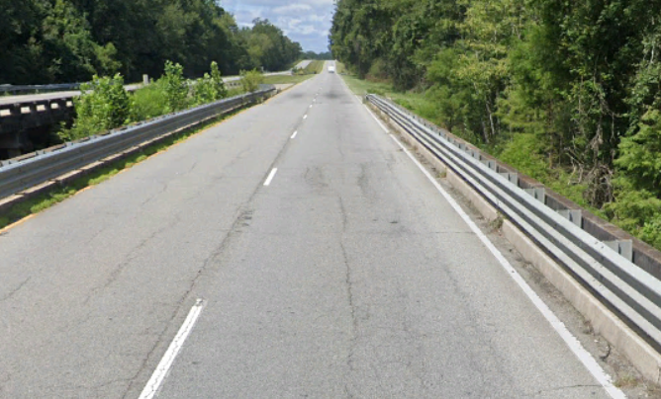
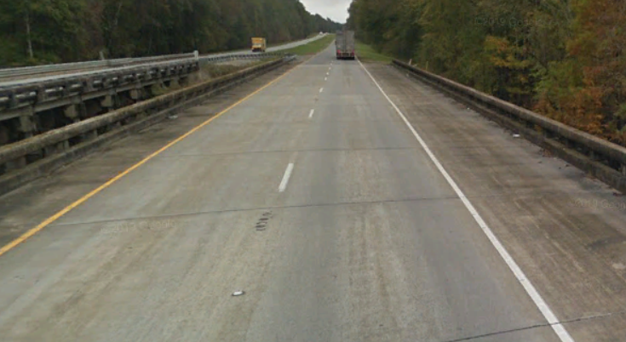
Anticipated Scope of Work
Replacement of the SB and NB Bridges
SB
NB

Slide 8
Anticipated Scope of Work
Demo Existing Bridge Structures
Build New Bridge Structures
Maintain one lane of traffic in each direction during construction
Approach Roadways for New Structures
Safety Improvements along US 301 connecting up two adjacent Safety projects

Slide 9
Structures
Identical twin flat slab bridges over Four Hole Swamp
Not replacing nearby structures over Indian Camp Branch
Prescribed bent locations to avoid existing substructure & line up bents
30’ & 40’ span lengths
Driven precast piles anticipated substructure type

Slide 10
Roadway
Maintain existing SB & NB horizontal alignments
Maintain existing median width
Provide adequate travelway & shoulder widths
Provide traffic safety countermeasures (pavement markings, rumble strips, 4’ paved shoulders, etc.)
4’ paved shoulders to close gap (MP 27.8 to MP 29.2)

Slide 11
Geotech
Final Bridge and Roadway Geotechnical Engineering Reports completed in 2016 and 2017 for southbound bridge. Reports will be provided.
Additional subsurface investigation being performed for northbound bridge including SPT borings and CPT soundings. Geotechnical Subsurface Data Report (GSDR) and Geotechnical Baseline Report (GBLR) will be provided to include previous and new information.

Slide 12
Geotech

Slide 13
Environmental
SCDOT will provide JD and linework.
Programmatic CE in process.
General Permit is anticipated. Use JD info to prepare.
Account for utility relocation impacts if necessary.

Slide 14
Anticipated Project Schedule
RFQ –
March 21, 2021
RFP for Industry – May 2022
Final RFP – June 2022
Public Announcement – August 2022
Contract Execution –
September 2022
Construction
Duration

Slide 15
Project Budget
$22.7 M approved in the STIP

Slide 16
Anticipated Project Information
Survey
Hazardous Materials
Hydrology
2017 Report
Structures
SI&A sheets
Plans Let in 2017
Utilities
Environmental
JD and line work for wetlands
Geotech
2017 Report

Slide 18
Questions/ Discussion

Slide 19
Feedback
Email: reynoldsbs@scdot.org

